Slide 1
INSURANCE ANALYTICS Group 3 Presentation
1 . Excel Dashboard
2 . Power BI Dashboard
3 . Tableau Dashboard
4 . SQL Dashboard

Slide 2
Project Members
1. Yogesh Hanmant Jadhav
2. Kiran Nitin Mane
3. Sanket Rajendra Ghadge
4. P Venkatesulu
5. Ajinkya Shivaji Yadav
6. Tej Chowdary Sunkara
7. Kiran Ashok Magar

Slide 3
Project Summary
The insurance analysis project analyses and processes individual performance.
The analysis was done in Excel, Power BI, Tableau, and SQL. It highlights the target of each executive. Further analysis of achievements in two categories-placed and invoiced achievements both calculated through sub-categories new, cross-sell, and renewal.
Then the percentage of achievements was calculated using the previous steps. The report includes the necessary KPIs such as yearly meeting count, total meetings conducted by each account executive, cross-sell, new and renewal charts, number of invoice by an account executive, open opportunities, and more.

Slide 4
Project Summary
The Insurance Analysis Project evaluates and processes the individual performance of account executives. The analysis was conducted using Excel, Power BI, Tableau, and SQL, focusing on key performance indicators (KPIs).
The project highlights each executive’s targets and achievements, categorized into placed and invoiced achievements, further segmented into new, cross-sell, and renewal business. Using these metrics, the percentage of achievements was calculated for better performance tracking.
The report includes essential KPIs such as yearly meeting count, total meetings per executive, cross-sell performance, new and renewal charts, invoice count per executive, open opportunities, and more. These insights help drive strategic decisions and improve overall business efficiency.

Slide 5
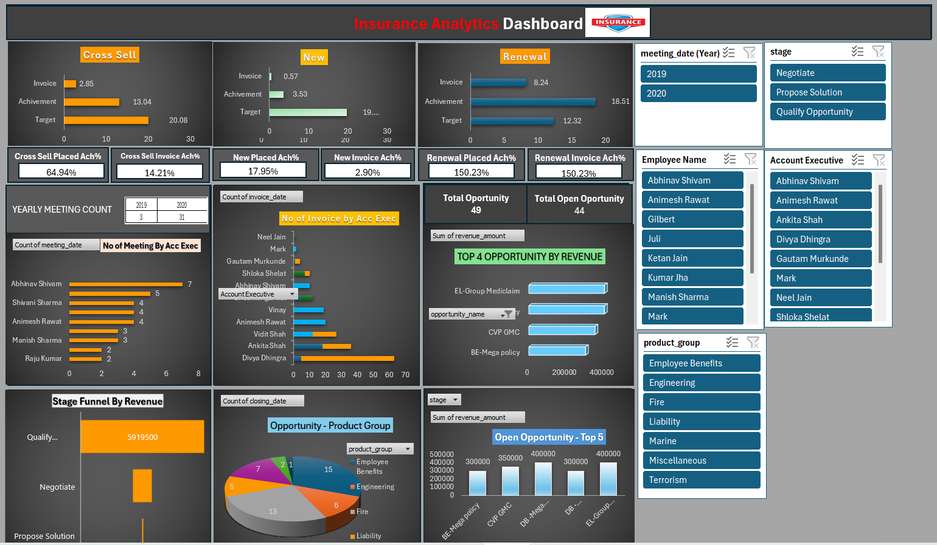
Excel Dashboard

Slide 6
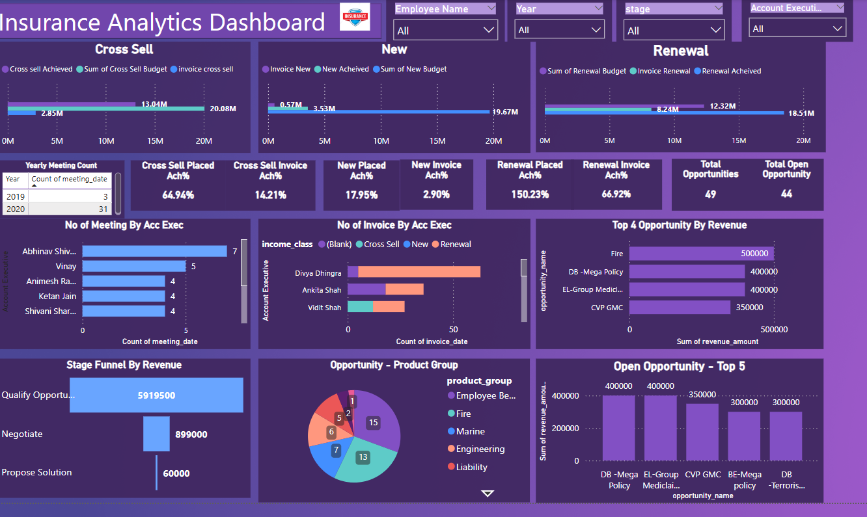
Power BI Dashboard

Slide 7
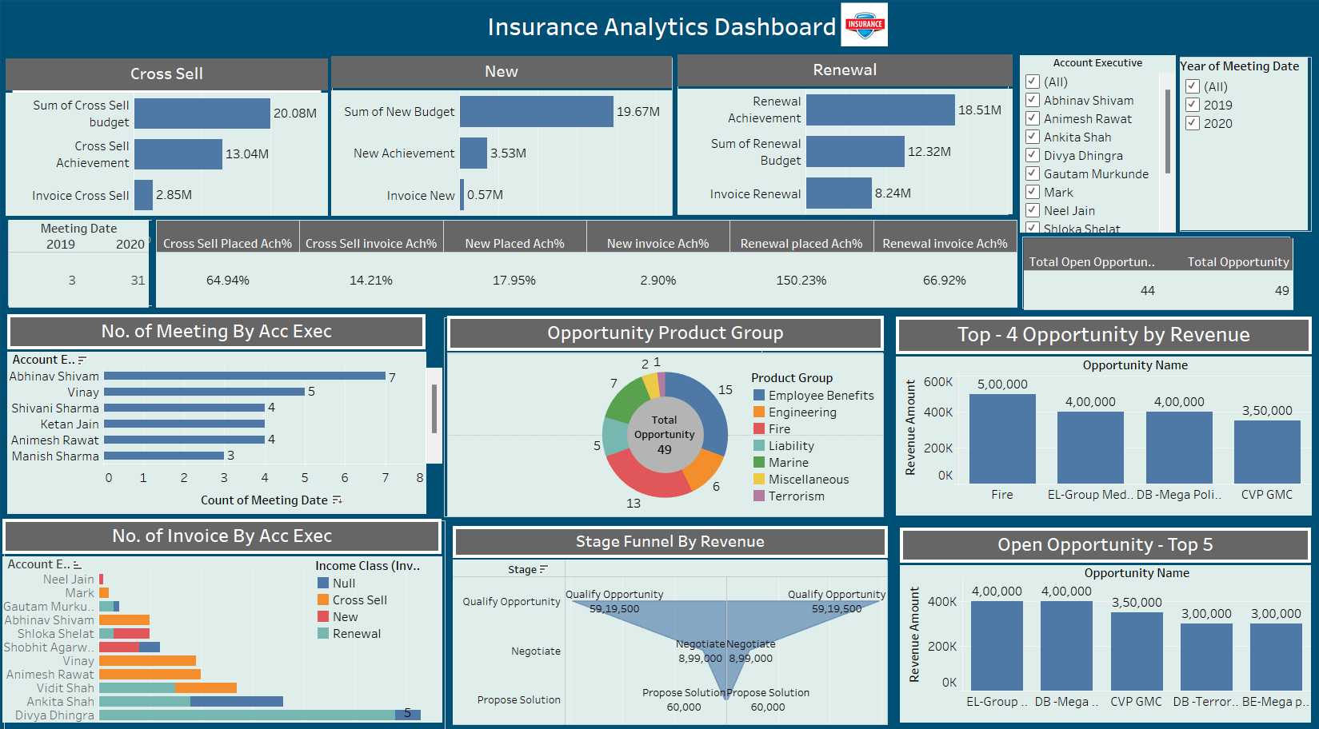
Tableau Dashboard

Slide 8
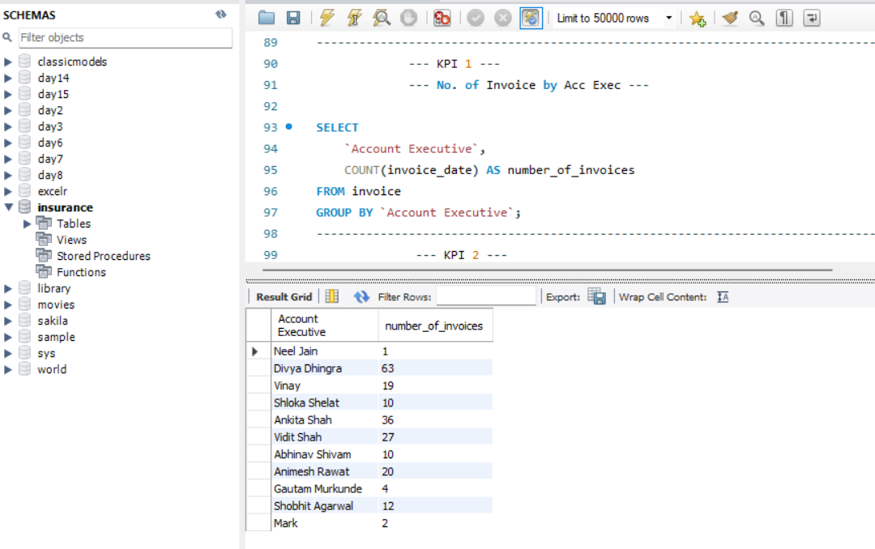
SQL Query 1 : No. of Invoice by Acc Exec

Slide 9
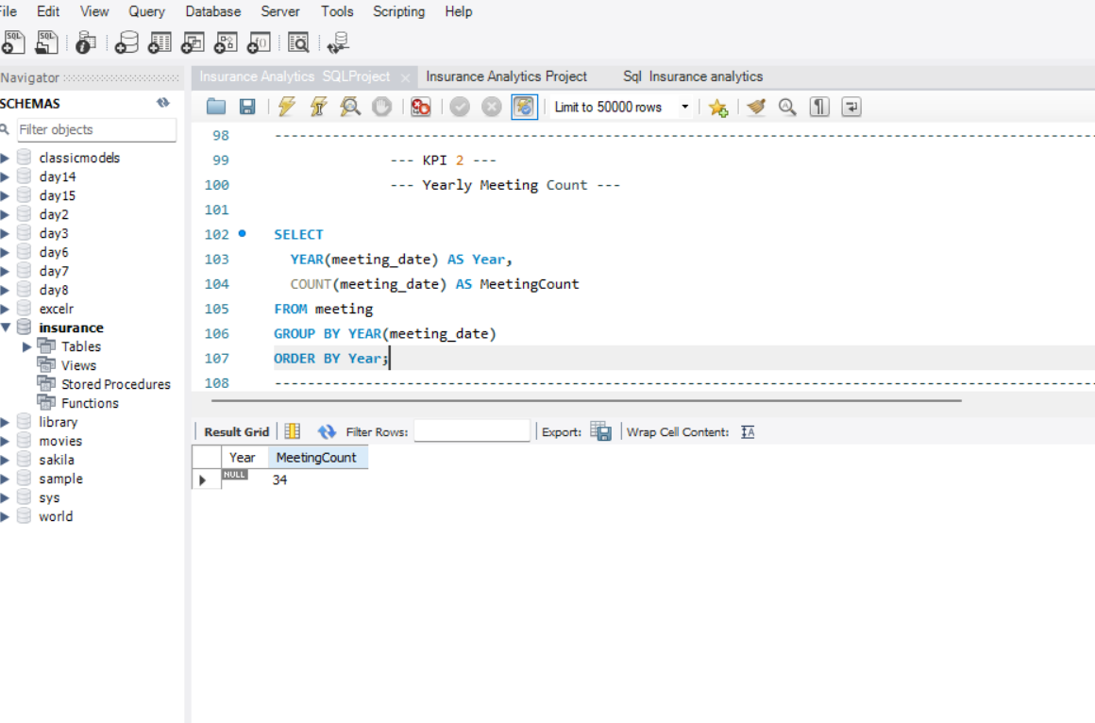
SQL Query 2 : Yearly Meeting Count

Slide 10
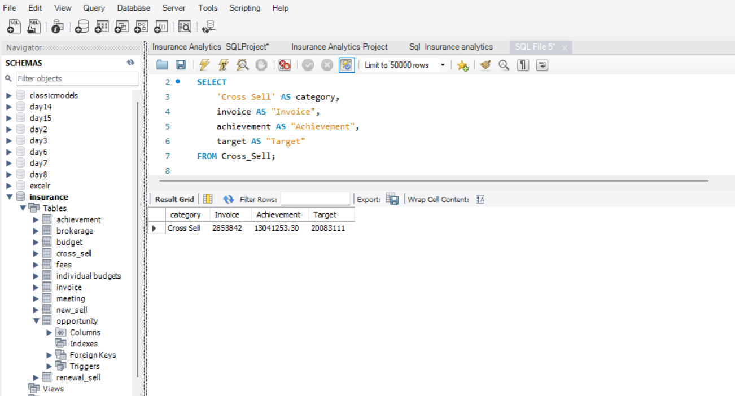
SQL Query 3.1 : Cross Sell – Target, Achieve, new

Slide 11
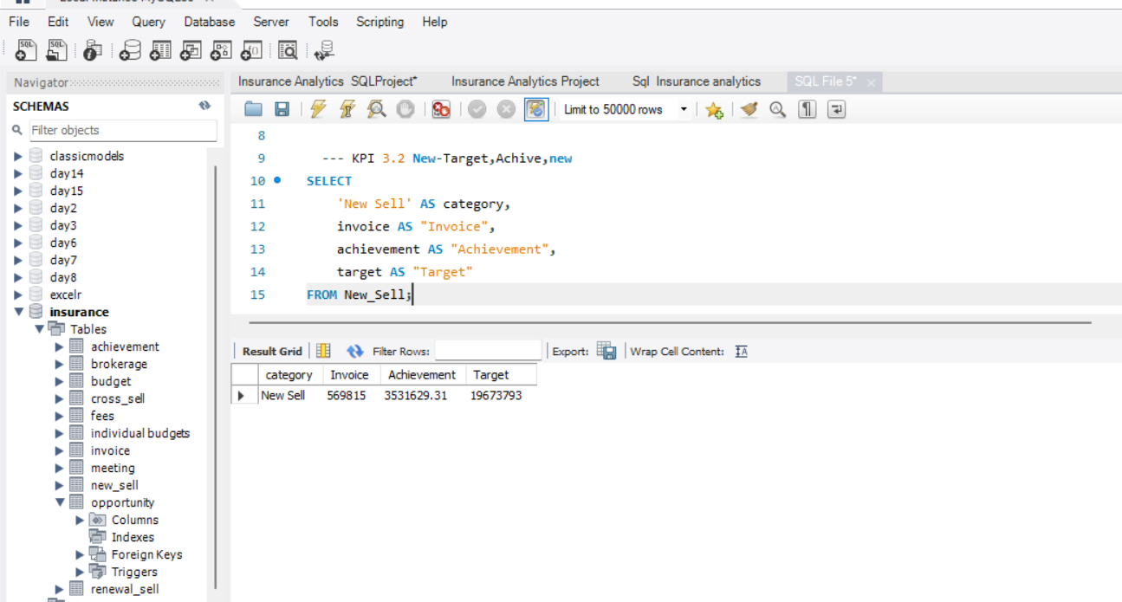
SQL Query 3.2 : New – Target, Acheive, new

Slide 12
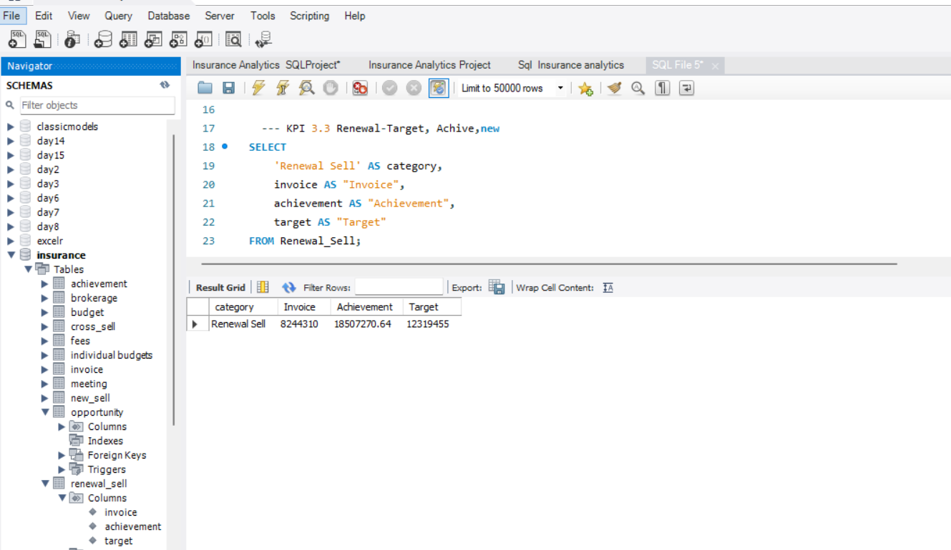
SQL Query 3.3 : Renewal – Target, Achieve, new

Slide 13
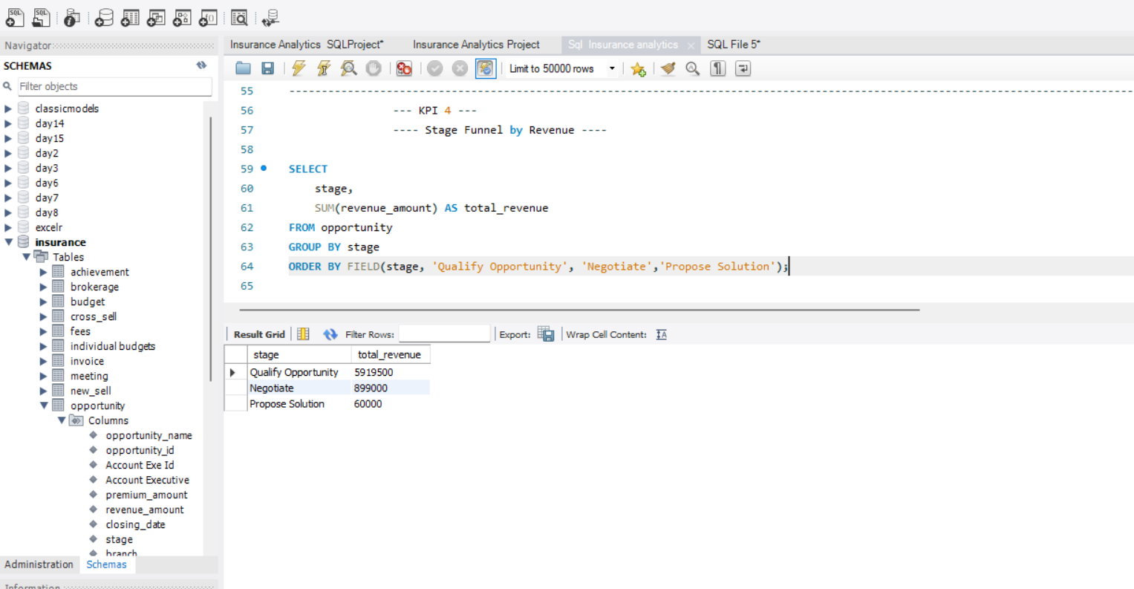
SQL Query 4 : Stage Funnel by Revenue

Slide 14
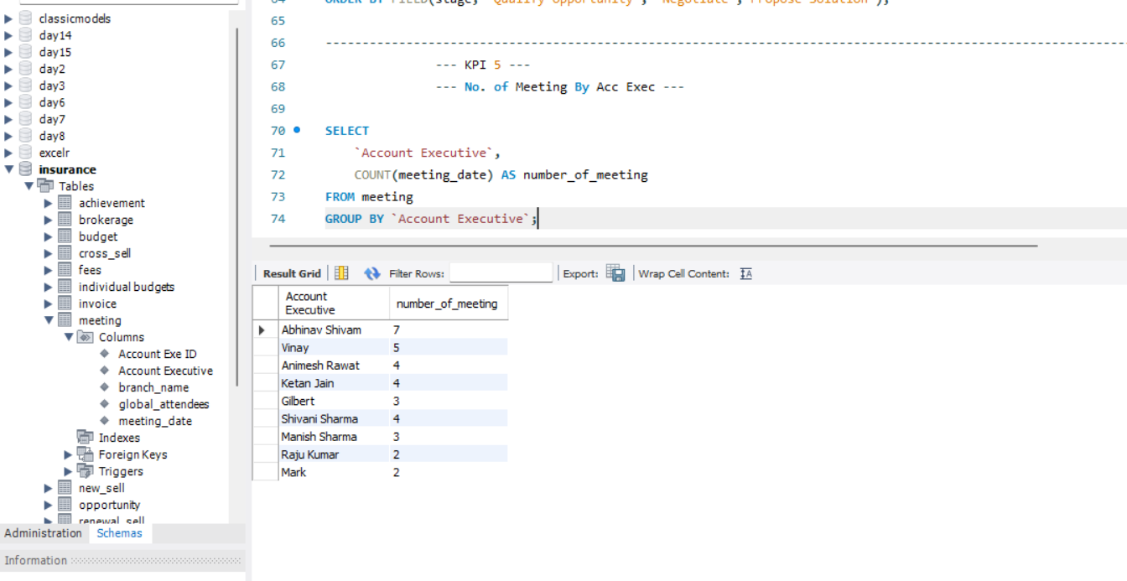
SQL Query 5 : No. of Meeting By Acc Exec

Slide 15
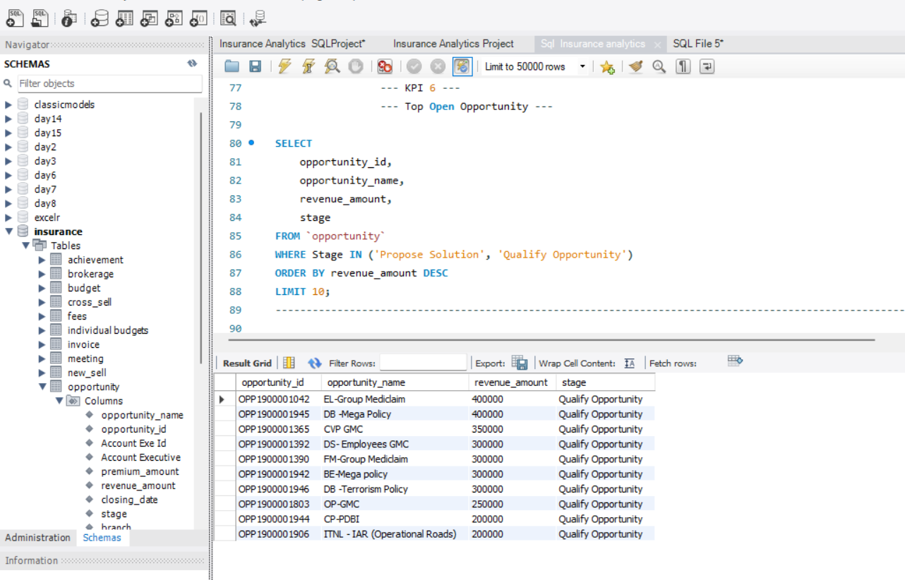
SQL Query 6 : Top Open Opportunity

Slide 16
Conclusion
The Insurance Analysis Project provides a comprehensive evaluation of account executives’ performance, leveraging Excel, Power BI, Tableau, and SQL to analyze key performance indicators (KPIs). By categorizing achievements into placed and invoiced business, further divided into new, cross-sell, and renewal segments, the project ensures precise tracking of individual and overall performance.
With insights into meeting counts, invoice performance, open opportunities, and conversion ratios, the analysis enhances strategic decision-making and fosters data-driven business growth. The structured approach helps identify top performers, improvement areas, and future sales opportunities, ultimately improving efficiency, revenue generation, and customer retention.
This project is instrumental in enhancing transparency, optimizing sales strategies, and driving continuous improvement within the organization.

Slide 17
THANK YOU GROUP 3

